Slide 1

The 4th Aim- Cost Analysis
Stacy Jepsen, MS, RN, APRN-CNS, CCRN
Liz Kozub, MS, RN, APRN-CNS, CNRN, CCRN

Slide 2
Objectives
Describe the importance of financial analysis in CNS practice and the tools/resource that can be used.
Utilize resources and tools that incorporate financial analysis into work led/supported by the CNS.

Slide 3
Outline
Background
  Linking cost to quadruple aim
  Shift in healthcare
  CNS strategic position
Measurement
  Cost analyst toolkit
  Formulas
  Resources
  Dissemination of project impact
Examples

Slide 4

Abbott Northwestern Hospital
Largest not-for-profit hospital in the Twin Cities area
Quaternary teaching medical center
952 licensed beds
Average daily census 475
Serves 200,000 patients / year
2,200 RNs
Magnet designated

Slide 5
Triple/Quadruple Aim
Quadruple aim based off the Triple Aim Framework (IHI 2007)
  Core goal to improve the lives of patients
CNS Focus:
  Quality care and outcomes
  Patient/family experience
  Workforce wellbeing
  Financial outcomes: often forgotten/neglected
Population health (Better Health)
Patient experience (Better Care)
Reducing cost per capita (Better Value)
Better healthcare workforce well-being

Slide 6


Importance: CNS Visibility
  CNS Role is primarily behind the scenes and worth their weight in gold.
Images from: https://www.savvysme.com.au/themes/savvy_bootstrap/img/upload/images/behind_the_scenes.jpg; https://starstruckworld.files.wordpress.com/2013/09/thankyou-card-front.jpg

Slide 7


CNS Impact of Bottom Line
Clinical expertise/outcomes
Business side of healthcare
Clinical
Operational
CNS
https://www.developer-tech.com/media/img/news/xiStock_bridgethegap233478348.jpg.800x600_q96.png.pagespeed.ic.r68bSmhEQn.png
https://www.google.com/search?q=hero&source=lnms&tbm=isch&sa=X&ved=0ahUKEwib8vqh2aXkAhVNX60KHVxxADYQ_AUIEigC&biw=1536&bih=717&dpr=1.25#imgrc=zjrSh4t6elbskM:&spf=1566999992318

Slide 8
Healthcare Shift
Healthcare costs are unsustainable
Year-over-year revenue growth reductions
Less need for hospital-based services
Increased scrutiny and transparency for quality and costs
Shift from volume to value-based care
Changes in payment and reimbursement (Medicare and commercial insurances)

Slide 9
Importance: Measurement
Outcome
Process
Balance
Outcome Measure
Mortality, infections, falls, readmission rate, patient satisfaction, financial impact
Process Measure
Percent time X intervention was done.
Balance Measure
Financial cost, readmission rate while reducing LOS

Slide 10
Cost of Care
To reduce total cost of care it must be defined and measured
Total cost of care
Variable Costs
All direct and indirect costs
Direct costs: labor, supplies, medication, testing
Indirect costs: productive of team, disease mortality, support services (none direct care, i.e. laundry)
Measures total cost of care- utilization and price
Utilization: services delivered during episode of care (direct and indirect)
Price: defined by payer perspective (how much is reimbursed for service)

Slide 11
Reducing Total Cost of Care
Moving beyond non-value added work (waste)
Reduce or hold steady costs while improving outcomes
Measuring actual cost per patient
Reduction strategies focus on key items:
How labor being utilized
Re-evaluation of supply costs
Prevent complications

Slide 12
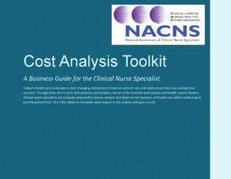
NACNS Cost Analysis Toolkit
NACNS Cost Analysis Toolkit
  Developed by the NACNS Practice Committee to
  help CNSs utilize business and cost analysis tools to
  describe and quantify CNS contribution to health care
  Includes-
    Guidance on cost analysis change strategy
    Assess to tools
    Literature review
    FAQ section generated from NACNS members and listserv surveys
  https://nacns.org/professional-resources/toolkits-and-reports/cost-analysis-toolkit/
NACNS Practice Committee (2016) Cost analysis toolkit: A business guide for the clinical nurse specialist. https://nacns.org/professional-resources/toolkits-and-reports/cost-analysis-toolkit/

Slide 13
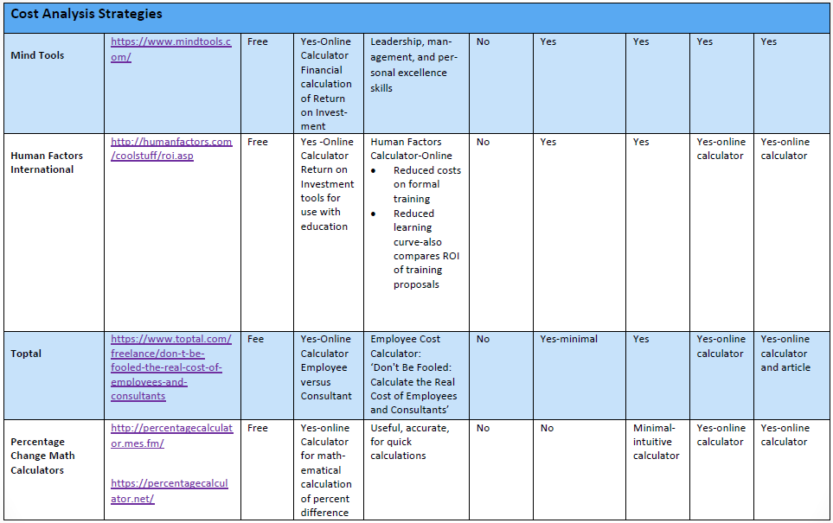
Cost Analysis Strategies
NACNS Practice Committee (2016) Cost analysis toolkit: A business guide for the clinical nurse specialist. https://nacns.org/professional-resources/toolkits-and-reports/cost-analysis-toolkit/

Slide 14
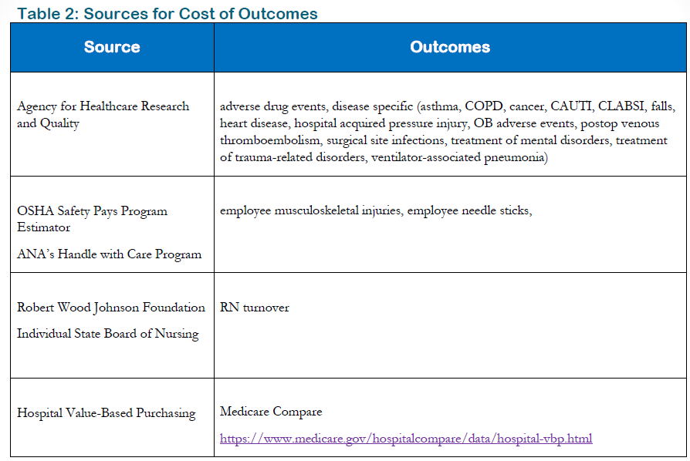
Sources for Cost of Outcomes
NACNS Practice Committee (2016) Cost analysis toolkit: A business guide for the clinical nurse specialist. https://nacns.org/professional-resources/toolkits-and-reports/cost-analysis-toolkit/

Slide 15

Cost Analysis Formulas
Cost Per Participant: Total cost of Program
Number of Participants
Benefit – Cost Ratio: Net Benefits
Total Cost
> 1 = positive financial impact
< 1 = negative financial impact
Return on Investment: Total Benefit – Total Cost x 100 = ___% ROI
Total Cost
Image from: https://cdn.aarp.net/content/dam/aarp/retirement/planning-for-retirement/2018/08/1140-running-out-of-money.imgcache.rev4bdcbf25300c3eceedb5e2e5c5e66922.jpg

Slide 16
Example: Cost Analysis for Education
CLABSI Education
Content Development Time | 6 hours x $XX (salary FTE)
Facilitator Cost | 2hrs x 4 sessions x $XX (salary FTE)
Length of Education | 2 hours
Number of Staff Attending | 68
Average Hourly Rate | $45
Total Costs: | $6,120
Cost Avoidance of 1 CLABSI | $46,000
Cost Per Participant: $90
Benefit-Cost Ratio: 7.5 (Net benefits / total cost: 46,000/6,120)
Return on Investment (assuming 2 infections prevented): 1,403%
(Total benefit – total cost/ total cost x 100: [92,000 – 6,120/6,120] x 100)

Slide 17
Example: Neuro Fall Clinical Action Team
Notes:
Liz

Slide 18
Example: Cortrak

Slide 19
Example: Cortrak

Slide 20
Example: Sedation/analgesia management in mechanical ventilated patients

Slide 21

Dissemination of Project Impact
Ways to demonstrate and communicate outcomes:
  Scorecard
  Dashboard
  Executive summary
  Presentations
I
Image from: https://i0.wp.com/www.jprarts.com/news/wp-content/uploads/2016/11/Extra-News.jpg?fit=1024%2C895&ssl=1

Slide 22
Scorecard
Jepsen S. (January/March 2015) Using a scorecard to demonstrate clinical nurse specialists’ contribution. AACN Advanced Critical Care, 26(1), 43-49.

Slide 23
Dashboard

Slide 24


Executive Summary

Slide 25
Example: Delirium Reduction for No Wake Zone (Sleep Promotion Initiative)

Slide 26
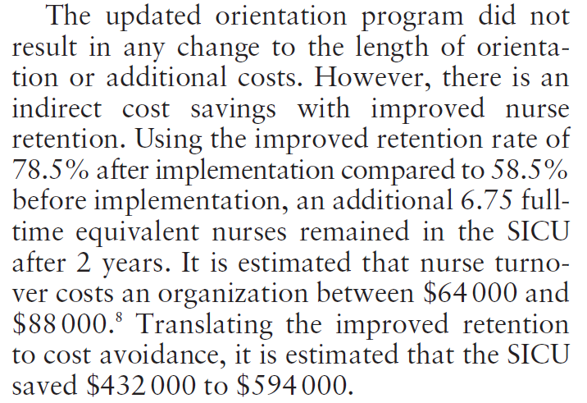
Example: Improved Nurse Retention
Kozub, E., Scheler, S., Necoechea, G., & O’Byrne (2017). Improving nurse satisfaction with open visitation in an adult ICU. Critical Care Nursing Quarterly, 40(2), 144-154.

Slide 27
Project: Sedation/analgesia management in mechanical ventilated patients

Slide 28
Cortrak

Slide 29
Summary
Quantifying outcomes is essential to CNS work
  Needs to include not only quality and patient satisfaction, but also financial impact
Variety of tools and resources to help quantify finances through the NACNS Cost Analysis Toolkit
Based on your audience, may need to tailor communication of outcomes

Slide 30
References
Bodenbeimer, T., Sinsky, C. (2014) From triple to quadruple aim: Care of the patient requires care of the provider. Annals of Family Medicine, 12(6), 573-576.
Centers for Medicare & Medicaid Services. (2017) National Health Expenditures 2017 Highlights. Retrieved August 18th, 2019, https://www.cms.gov/Research-Statistics-Data-and-Systems/Statistics-Trends-and-Reports/NationalHealthExpendData/NationalHealthAccountsHistorical.html
Institute for Healthcare Improvement (2017) The triple aim or the quadruple aim? Four points to help set your strategy. Retrieved August 16th, 2019, http://www.ihi.org/communities/blogs/the-triple-aim-or-the-quadruple-aim-four-points-to-help-set-your-strategy
Jepsen S. (January/March 2015), Using a scorecard to demonstrate clinical nurse specialists’ contribution. AACN Advanced Critical Care, 26(1), 43-49.
Kozub, E., Scheler, S., Necoechea, G., & O’Byrne (2017). Improving nurse satisfaction with open visitation in an adult ICU. Critical Care Nursing Quarterly, 40(2), 144-154.
NACNS Practice Committee (2016) Cost analysis toolkit: A business guide for the clinical nurse specialist. https://nacns.org/professional-resources/toolkits-and-reports/cost-analysis-toolkit/

