Slide 1
A Guide to Understanding Basic Pharmacogenomics
Jessica Wright, PharmD, BCACP Pharmacogenomics Medication Therapy Management Pharmacist
Center for Individualized Medicine
Mayo Clinic
Notes:
How RN will be impacted
Responseible for safe
Expected action and outcome. Look at ANA competencies.
Monitoring medication response
Pt education
Why doeds it matter” 23and me will have it.
Prodrug vs acive drug. How metabolic status is reported.
Audience participation.
Show common meds in everyday practice metabolized by CYP2D6.
Try not to overwhelm RN- how to ID issues and bring to attn of expert
Show conditions that PGX can impact- see ONeOME
Tamoxifen for oncology RN
Succal swab in RN inpt area
Outside
ID, support, Edu, refer.
Suzanne Mahon, Clinical Journa of Onoclogy Nursing 2017, 21(1), 34-38. → talks about Pgx

Slide 2
Conflict of Interest Disclosure
I have no financial or relevant conflict of interest to disclose

Slide 3
Have you..
Received direct-to-consumer genetic testing?
Had pharmacogenomics (PGx) testing?
Had a patient with PGx test results?
Had a patient who asked you PGx-related questions?
Heard of the approximate cost 3 years ago? Now?
Notes:
Talk about Mayo Clinic GeneGuide has pharmacogenomic genes included in their reporting. 23&Me will soon have it.

Slide 4
Objectives
Review basic concepts and terminology relevant to pharmacogenomics (PGx)
Navigate through common format themes of PGx test reports
Describe safety challenges and opportunities when patients present with their Direct-to-Consumer PGx test reports
Identify PGx resources
Notes:
Explain importance for a staff nurse to understand pharmacogenomics basic concepts
Provide examples when pharmacogenomics test results can and cannot be used
Identify common medications and disease states in which pharmacogenomic testing may be of benefit
List key patient education points for pharmacogenomic testing

Slide 5
Leading causes of Death in US (2015)
Heart disease: 635,260
Cancer: 598,038
Accidents (unintentional injuries): 161,374
Chronic lower respiratory diseases: 154,596
Stroke (cerebrovascular diseases): 142,142
Alzheimer's disease: 116,103
Diabetes: 80,058
Drug-induced causes: 55,403
Influenza & pneumonia: 51,537
Nephritis, nephrotic syndrome, and nephrosis: 50,046
Intentional self-harm (suicide): 44,965
Murphy SL, et al. Deaths: Final Data for 2015. National Vital Statistics Reports. 2017; 66(6):1-73.

Slide 6
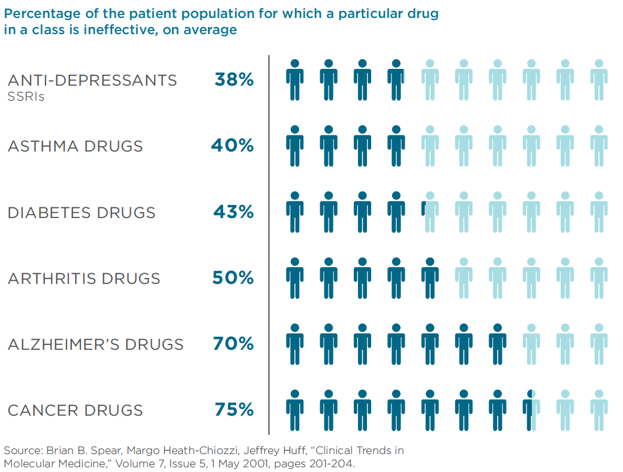

Slide 7
Factors Related to Drug Responses
Race / Ethnicity
Medication compliance
Huang SM, Goodsaid F, Rahman A, et el. Toxicology Mechanisms and Methods. 2006;(16) 89-99.
Notes:
Change to pics

Slide 8
What is pharmacogenomics?
Study of genetic variations that influence individual response to drugs
Same Condition
No Response
Desired Response
Toxic Side Effects

Slide 9
Three domains of pharmacogenomics effects
1
Hypersensitivity
2
3
Efficacy
Toxicity
Notes:
Not universal icons

Slide 10
How are staff nurses impacted by PGx?
Standards of Practice (American Nurses Association, 2010, 3rd ed.)- selected competencies
“The registered nurse collects pertinent data and information relative to the healthcare consumer's health or the situation”
Understand expected action and outcome of medications
“The registered nurse identifies expected outcomes for a plan individualized to the healthcare consumer or the situation.”
Notes:
“The registered nurse collects pertinent data and information relative to the healthcare consumer's health or the situation” → Nurse can ask pt about prior PGx testing.
Responsible for safe medication administration
Understand expected action and outcome of medications
Patient education

Slide 11
How are staff nurses impacted by PGx?
Standards of Practice (American Nurses Association, 2010, 3rd ed.)- selected competencies
Monitoring medication response
“Uses feedback and evaluations from the healthcare consumer to determine the effectiveness of the employed strategies.”
Patient education
“Provides healthcare consumers with information about intended effects and potential adverse effects of the plan of care.

Slide 12
Metabolizer status & drug exposure
Poor metabolizer
Intermediate
Normal
Rapid
Ultrarapid
Legend
Active Drug
Prodrug
Drug Exposure
Drug Exposure

Slide 13
Metabolizer Status may impact drugs differently
Active Drug
Active → Inactive
Poor metabolizer =
too much drug
Metoprolol is metabolized by CYP2D6 then eliminated
Prodrug
Inactive → Active
Poor metabolizer =
too little drug
Tamoxifen is converted to its active metabolite by CYP2D6
M. Whirl-Carrillo, E.M. McDonagh, J. M. Hebert, L. Gong, K. Sangkuhl, C.F. Thorn, R.B. Altman and T.E. Klein. "Pharmacogenomics Knowledge for Personalized Medicine"Clinical Pharmacology & Therapeutics (2012) 92(4): 414-417.

Slide 14
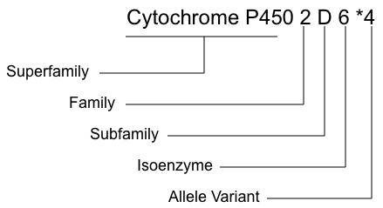
Nomenclature
Nelson, DR, Pharmacogenetics 1996; 6. 1–42

Slide 15
Common medications in which PGx may be relevant (not all inclusive)
Allopurinol
All proton pump inhibitors
Omeprazole, pantoprazole
Most antidepressants
Citalopram, escitalopram, fluoxetine, amitriptyline, nortriptyline, etc.
Simvastatin
Clopidogrel, metoprolol
Tramadol
M. Whirl-Carrillo, E.M. McDonagh, J. M. Hebert, L. Gong, K. Sangkuhl, C.F. Thorn, R.B. Altman and T.E. Klein. "Pharmacogenomics Knowledge for Personalized Medicine" Clinical Pharmacology & Therapeutics (2012) 92(4): 414-417.

Slide 16
Conditions in which PGx testing may be relevant (not all inclusive)
Gout
Gastroesophageal reflux disease (GERD)
Depression/anxiety
Hyperlipidemia
Coronary artery stents
Pain
M. Whirl-Carrillo, E.M. McDonagh, J. M. Hebert, L. Gong, K. Sangkuhl, C.F. Thorn, R.B. Altman and T.E. Klein. "Pharmacogenomics Knowledge for Personalized Medicine" Clinical Pharmacology & Therapeutics (2012) 92(4): 414-417.

Slide 17
When PGx testing may be inaccurate
Allogeneic (donor other than self) stem cell transplant
Liver transplant
Langman LJ, Nesher L, Shah DP, Azzi JM, Shpall EJ, Rezvani K, Black JL 3rd, Chemaly RF. Challenges in determining genotypes for pharmacogenetics in allogeneic hematopoietic cell transplant recipients. J Mol Diagn. 2016 Sep;18(5):638-642,
Kisor DF, Bodzin AS. Pharmacogenomics in liver transplantation: testing the recipient and the ex-vivo donor liver. Pharmacogenomics (2018) 19(9), 753-756.

Slide 18
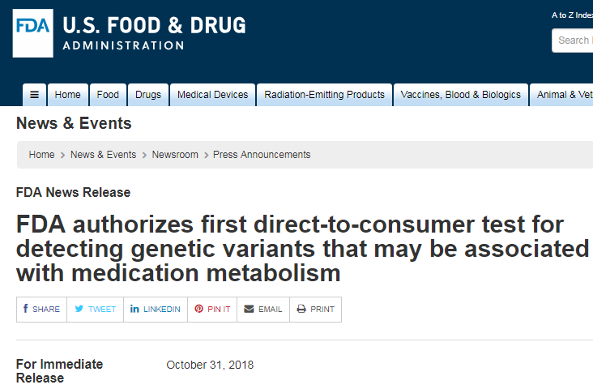
Safety challenges and opportunities with Direct to Consumer (DTC) PGx testing
Notes:
How many audience members were aware of this?

Slide 19
FDA’s statement on 23andMe’s PGx test
“Any medical decisions should be made only after discussing the results with a licensed health care provider and results have been confirmed using clinical pharmacogenetic testing.”
“Results from this test should be confirmed with independent pharmacogenetic testing before making any medical decisions.”
U.S. Food & Drug Administration. FDA News Release. Silver Spring, MD. https://www.fda.gov/NewsEvents/Newsroom/PressAnnouncements/ucm624753.htm Updated 11/02/2018. Accessed 12/11/2018.

Slide 20
Safety challenges with direct to consumer PGx testing
Screening test → not diagnostic
Confirmatory testing needed prior to use
Potential for “false normals”
Electronic health record alerts
Lab A - DTC
Lab B - Clinical

Slide 21
Common PGx Panel test report format styles

Slide 22
Stoplight format
Red: Major gene-drug interaction
Yellow: Moderate gene-drug interaction
Green: Minimal or no gene-drug interaction
- OR -
Major
-Drug A
Moderate
-Drug B & C
Minimal / None
- Drug D, E & F

Slide 23
Drug-specific format
Drug-specific comments or recommendations
Example PGx Report
Drug A: Reduce starting dose by 50% and titrate cautiously
Drug B: Standard dosing recommended
Drug C: Consider alternative therapy due to increased risk of therapeutic failure

Slide 24
Educating patients with PGx test results
Don’t stop or change medications without talking to your healthcare provider
Results are guidelines only
Doesn’t apply to all medications
Results only apply to the person bring tested
Blood-relatives may be impacted
Ask your healthcare provider and/or pharmacist if you are prescribed a medication listed as having a drug-gene interaction on the report

Slide 25
PGx Case example

Slide 26
Case: Judy
Initial Presentation:
72 year old female
Presents with recent PGx test report
HPI: Persistent depressive symptoms
On sertraline 200mg daily x 4 months with only minimal improvement.
Not effective: Citalopram 20mg daily x 6 months
Medications:
Aspirin, allopurinol (started 3 days ago), sertraline, pantoprazole, metoprolol (started 10 years ago)

Slide 27
Notes:
Mention quickly

Slide 28
Notes:
Mention quickly

Slide 29
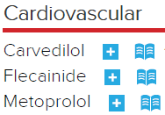
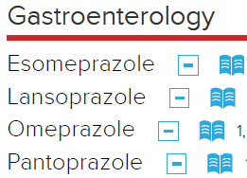
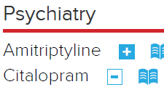
Case: Drug-Gene Interactions
Notes:
Sertraline – intermediate - normal → what activity level is this?

Slide 30
What questions should the staff nurse ask Judy?
Any history of liver or allogeneic stem cell transplant?
Any other prior pharmacogenomic testing?
Assess response to medication (side effects/ efficacy)

Slide 31
Case: Plan for Judy
Switch allopurinol to febuxostat
Switch sertraline to bupropion
PGx could explain why citalopram was not effective
Increase dose of pantoprazole
40mg daily → 80mg BID
Continue metoprolol. Continue to monitor for side effects.

Slide 32
What education should the staff nurse provide Judy?
A. Don’t stop medications until discussing with your healthcare provider
B. Any medication listed as not having a gene-drug interaction will be safe for you
C. Blood relatives might be impacted.
D. Your kids should not take pantoprazole, allopurinol.
E. Answers A & C
F. Answers B & D

Slide 33
What if…?
Judy’s PGx report is now 5 years old. She starts a medication just approved by the FDA last month. Medication is not listed on the PGx report. What should the staff nurse do?
A. Reassure Judy that no gene-drug interaction exists.
B. Ask a healthcare provider or pharmacist if a gene-drug interaction exists.
C. Tell Judy that she should not take this medication.

Slide 34
What if…? (part 2)
Judy’s sister, Trudy, presents with DTC PGx testing
What should the staff nurse tell Trudy?
Confirmatory testing and discussion with healthcare provider should occur prior to using results

Slide 35
Pharmacogenomics resources
www.pharmgkb.org > 100 medications
Clinical Pharmacogenomics Implementation Consortium (CPIC)
Dutch Pharmacogenetic Working Group
Canadian Pharmacogenomics Network for Drug Safety
Pharmacists → PGx is similar to a drug-drug interaction

Slide 36
Summary
PGx is one of many variables in drug response
Staff nurses can become familiar with different PGx test report formats
Staff nurses can ask patients about prior PGx testing including DTC testing, liver & stem cell transplants, assess medication response, and educate patients
PGx resources
www.PharmGKB.org, pharmacists

Slide 37
Acknowledgements
Center for Individualized Medicine (CIM)
CIM Education Team
Pharmacogenomic Task Force

Slide 38
QUESTIONS?

