Slide 1
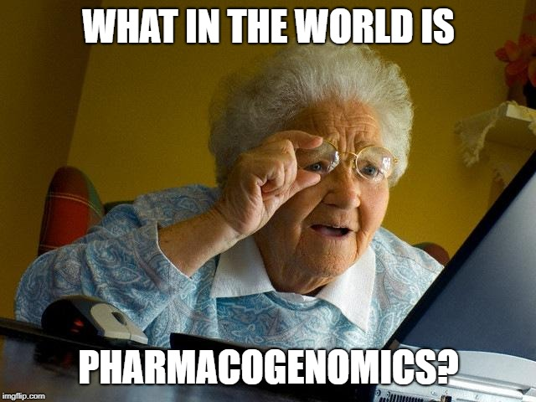
Clinical Implications of Opioid Pharmacogenomics
John Trnka, Pharm.D., R.Ph.
Mayo Clinic Health System-Mankato
NACNS Conference: April 6, 2019
Notes:
Interpatient variability in medication response is a well-known phenomenon. Certain patients respond as expected to certain therapies, whereas others do not respond at all or experience adverse effects. This variation in response is due to clinical and environmental factors such as age, body weight, renal or hepatic function, comorbidities, and concomitant medications. Over the last several decades, genetic polymorphisms have been proven to be one of the main culprits of medication response variability.1 Pharmacogenetics—the study of the influence of genetic variants on medication response—has been directly implicated in the management of many medical conditions, including pain. While there are many treatment options for pain, opioids have been used commonly to manage moderate to severe pain. While they are generally safe, some patients may experience an increase in adverse effects. This variation is typically blamed on genetic polymorphisms. This presentation will focus of the pharmacogenomics of opioids and how to adopt the findings into clinical practice.

Slide 2
Disclosure Statement
John Trnka, Pharm.D., R.Ph.
  Declares no financial relationships pertinent to this session
  Declares off-label use of medication will not be discussed during this presentation

Slide 3
Objectives
Discuss opioid pharmacology, analgesic potency, and major metabolism pathways
Review current literature and guideline recommendations surrounding the use of pharmacogenomics for pain management
Develop a pain management plan for a patient using pharmacogenomic data

Slide 4
Pharmacogenomics Refresher
Notes:
I know you heard this about 10 minutes ago, but it’s early and repetition is good
This will help lay the foundation for the presentation and help understand the basics of pharmacogenomics

Slide 5
Basic Concepts to Remember
Pharmaco:
kinetics
genomics
dynamics
Notes:
Kinetics: what the body does to the drug (ADME)
Dynamics: what the drug does to the body
Genomics: how a person’s genes affect the body’s response to drugs

Slide 6
Cytochrome P450 System
CYPs of Interest
Types of Metabolizers (phenotypes)
CYP1A2
CYP2C9
CYP2C19
CYP2D6
CYP3A4
CYP3A5
Ultra-rapid
Rapid
Normal
Intermediate
Poor
Notes:
Family of enzymes in the liver responsible for the metabolism of drugs, estimated to be 70-80% of enzymes involved in drug metabolism
For example CYP 2D6 has over 100 variants, leading to a lot of variability in function

Slide 7
Prodrugs
A compound that has little or no activity on a desired pharmacologic target, but is converted to an active, or more active form by metabolism
  Examples
    Codeine
    Tramadol
    Venlafaxine
    Tamoxifen
    Clopidogrel
Notes:
Take a look at ask mayo expert
it mentions for poor metabolizers, the concern is with decreased efficacy
however, there are some papers that cite reports of patients with intolerances or tachycardia side effects who are CYP2D6 PM

Slide 8
Opioid Pharmacology Review

Slide 9

Opioid Pharmacology
Three opioid receptor subtypes
  $μ, δ, κ$
Multiple endogenous ligands that act on various opioid receptors
Clinically utilized opioids are agonists at μ-opioid receptors (MORs)
  Receptors are distributed throughout CNS and PNS
    OPRM1 codes for MORs and is highly polymorphic
Notes:
Each opioid receptor subtype is responsible for
Lots of drugs are antagonists, but these are agonists (activates a receptor in the brain)
Mu agonists have other off-target effects as well
PNS: includes the enteric nervous system
OPRM1 has over 100 identified variants, may explain differences in opioid response

Slide 10
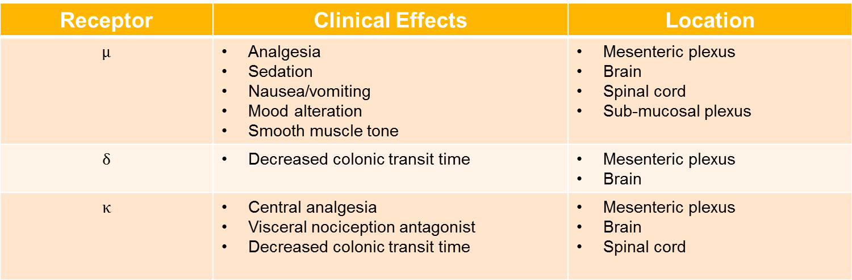
Opioid Receptors

Slide 11
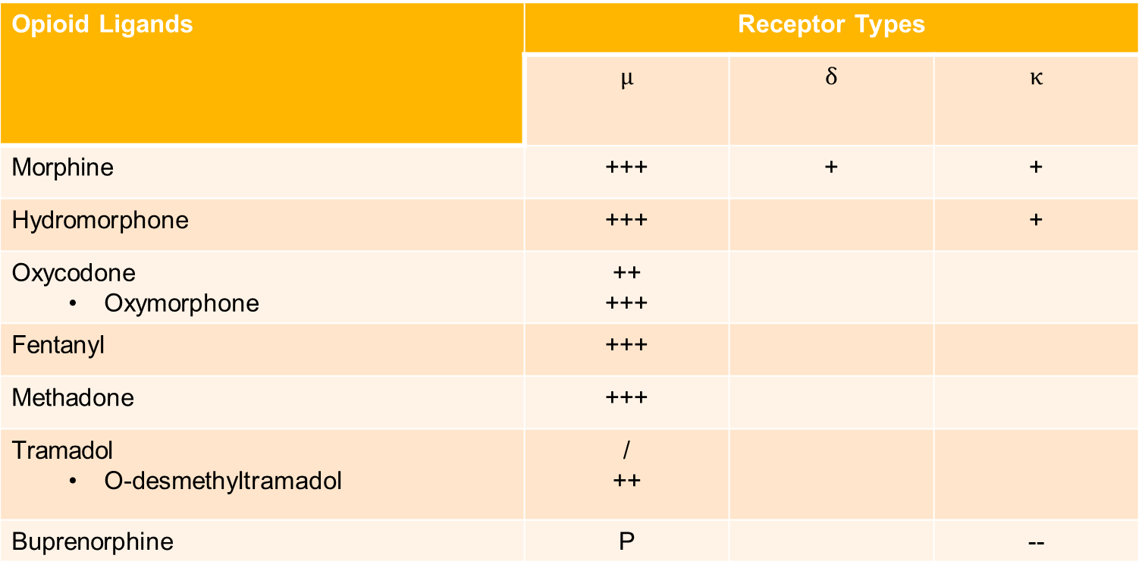
Opioid Binding Profiles
Opioid Ligands | Receptor Types
 | $$μ$$ | $$δ$$ | $$κ$$
Morphine | +++ | + | +
Hydromorphone | +++ |  | +
Oxycodone Oxymorphone | ++ +++
Fentanyl | +++
Methadone | +++
Tramadol O-desmethyltramadol | / ++
Buprenorphine | P |  | --
+, agonist; −, antagonist; P, partial agonist. In potency: /<+ < ++ < +++
Notes:
Tramadol itself has more action on the inhibition of serotonin and norepinephrine uptake, whereas the major metabolite is responsible for the opioid receptor affinity and pain relief
Tramadol binds at 4000 less affinity than morphine, metabolite about 10 x as less than morphine

Slide 12
Opioid Pharmacology Continued
Opioid analgesics are extensively metabolized in the liver and eliminated renally
  Unique pathway for each agent
    Includes both phase 1 and phase 2 metabolism
Known polymorphisms in key phase 1 and phase 2 enzymes
Possibility of interpatient variability of opioid response
Notes:
Phase 1: inactivates or activates drug, sometimes to a more potent form than the parent drug
Phase 2: allows for a drug to be eliminated

Slide 13
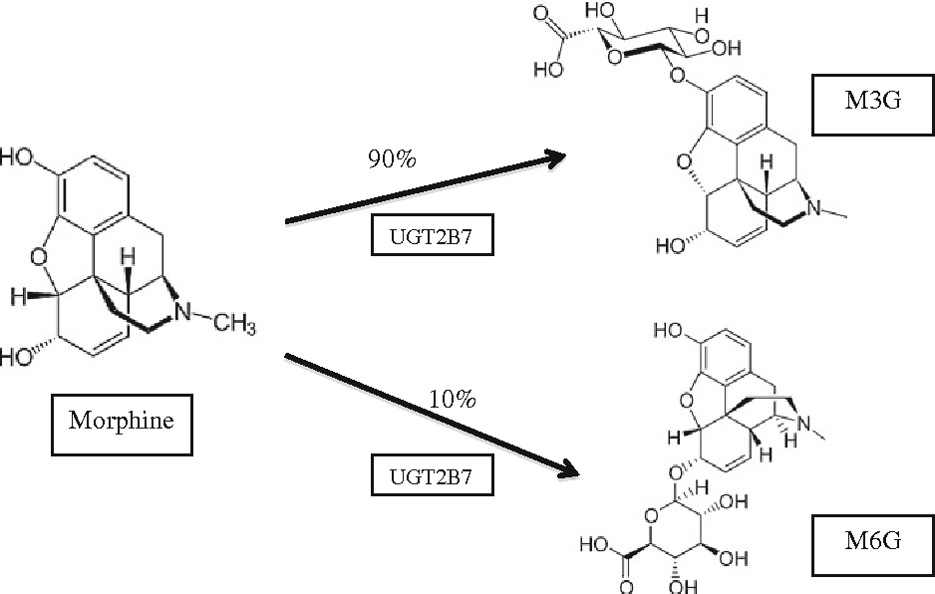
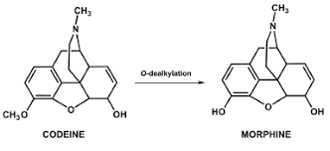
Phase 1 vs Phase 2 Metabolism
Phase 1 Metabolism
Phase 2 Metabolism
Notes:
Transfer of glucuronic acid to substrate

Slide 14
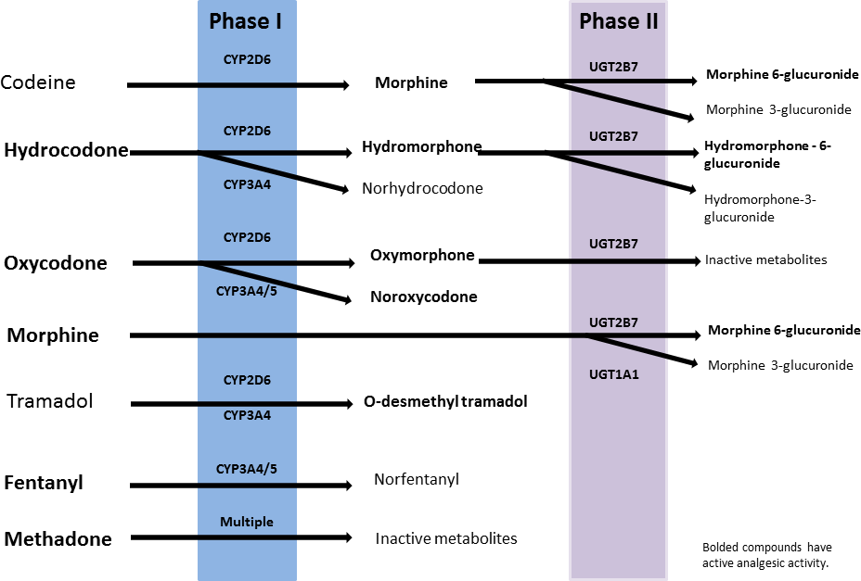
Notes:
Bolded compounds have pharmacologic activity
Morphine 6 glucuronide has more pharmacologic activity than morphine itself and can accumulate in renal failure (5-10% metabolized in parent drug)

Slide 15
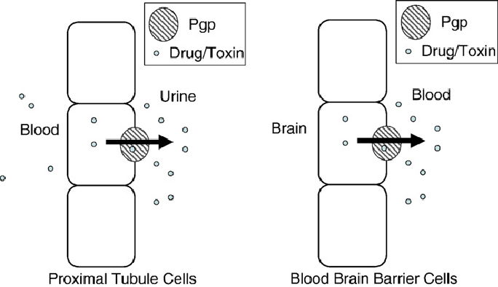
Genes of Interest
Phase I Enzymes
  CYP2D6
  CYP2B6
  CYP3A4
  CYP3A5
Phase II Enzymes
  UGT2B7
  UGT1A1
Other
  COMT
  ABCB1
Notes:
Catechol-o methyltransferase: plays a role in the metabolism of catecholamine neurotransmitters, which may play a role in pain sensitivity
ABCB1: codes for an efflux pump (p-glycoprotein transporter), which is responsible for first-pass metabolism moving substrates from the liver to the small intestine or blood to urine (i.e. for opioids this would remove the drug from the hepatocyte out to the small intestine for elimination)

Slide 16
Opioid Dosing and Adverse Effects
Start at lowest effective dose for shortest duration of time
Multiple adverse effects
Utilize equianalgesic opioid dosing and factor in cross-tolerance
Tolerance | Dependence | Addiction
Diminished response to a drug after repeated use | A physical condition in which the body has adapted to the presence of a drug | Compulsive drug-seeking and use, despite harmful consequences
Notes:
Fentanyl patches should only be used in patient who need chronic therapy and are not opioid naiive
Miosis
Respiratory depression
Nausea/vomiting
Pruritus
Constipation
Addiction
Tolerance: needing higher doses of opioids
Dependence: may need detox due to withdrawal, physiological need (ie opioids or prednisone)
Addiciton: illegal activities to obtain and use more drug

Slide 17
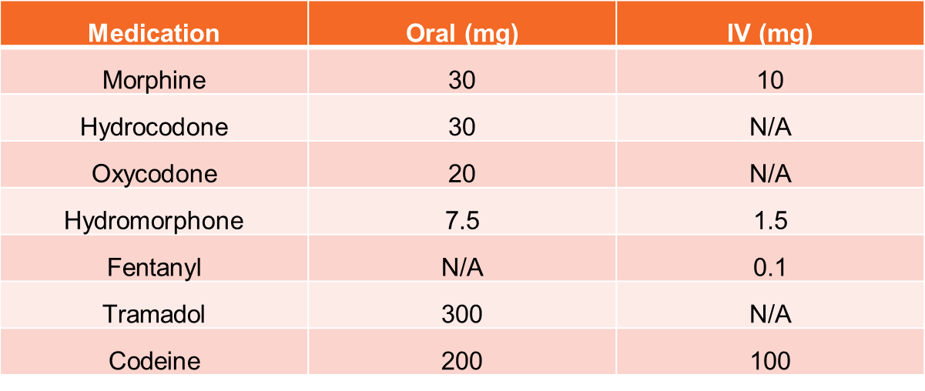
Morphine Milligram Equivalent Doses
Notes:
Not all opioids are created equal!
Fentanyl is difficult to convert, there is a dosing guide for transdermal formulation available in package insert
IV has multiple different conversion factors
Methadone not included as potency increases with increasing doses
When changing between formulations, standard of practice is to reduce dose by 25-50% to control for incomplete cross tolerance

Slide 18
Fentanyl Patch Conversion
PO 24-hour morphine (mg/day) | Fentanyl Patch Dose (mcg/hr)
45-134 | 25
135-224 | 50
225-314 | 75
315-404 | 100
405-494 | 125
495-584 | 150
585-674 | 175
675-764 | 200
765-854 | 225
855-944 | 250
945-1034 | 275
1035-1124 | 300
Notes:
Adding total morphine dose with scheduled and average PRN doses, then convert to patch

Slide 19
Opioids Commonly Used for Acute and Chronic Pain
Drug | Bioavailabilty (PO) | Half-life (IR formulations) | Clearance Mechanisms | Comments
Morphine | 30% | 3 hours | Liver metabolism Glucuronidation Renal clearance | Metabolites M3G and M6G are problematic in renal failure
Oxycodone | 70% | 2.5 hours | Mainly liver metabolism (CYP) ~20% renally cleared | Active metabolite is more potent than parent drug
Hydromorphone | 30% | 2.5 hours | Hepatic metabolism Glucuronidation Active metabolite (H6G) can accumulate in renal dysfunction | Significantly more potent than morphine and oxycodone
Fentanyl | 50% (lozenge) | 3 hours (following an IV dose) | Liver metabolism (CYP 3A4) No active metabolites | Should not be used in opioid-naive patients
Methadone | 40-90% | 15-60 hours | Liver metabolism (CYP) No active metabolites | Complex pharmacokinetics
Codeine | 60% | 3 hours | Liver metabolism Variable amount is converted to morphine | Significant variability in analgesic response
Tramadol | 70% | 6 hours | Liver metabolism Active metabolite is important for therapeutic effect | Risk of serotonin toxicity
Notes:
All are hepatically metabolized

Slide 20
Which of the following is true regarding the pharmacology of opioids?
Phase 1 metabolism is responsible for converting morphine to it’s inactive metabolites
Hydrocodone has no MOR activity and requires activation via phase 1 metabolism
Analgesic response is an example of pharmacokinetics
Patients with overactive CYP 2D6 enzymes would be expected to have increased analgesic effects from codeine

Slide 21
Which of the following is true regarding the pharmacology of opioids?
Phase 1 metabolism is responsible for converting morphine to it’s inactive metabolites
Hydrocodone has no MOR activity and requires activation via phase 1 metabolism
Analgesic response is an example of pharmacokinetics
Patients with overactive CYP 2D6 enzymes would be expected to have increased analgesic effects from codeine

Slide 22
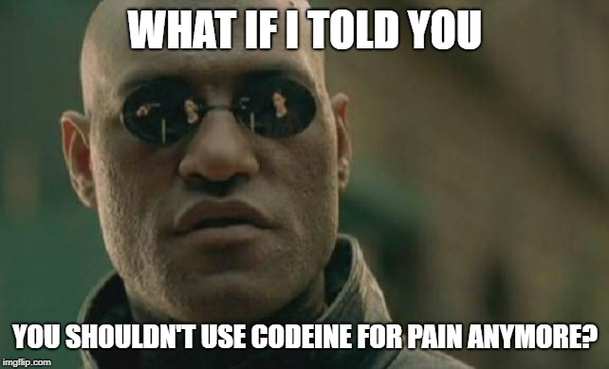
Clinical Implications of Opioid Pharmacogenomics

Slide 23
Guidelines for Opioid Pharmacogenomics
Clinical Pharmacogenetics Implementation Consortium (CPIC) guidelines
  Developed to help clinicians understand how test results should be utilized clinically
  22 published guidelines
    Codeine is the only opioid with a dedicated guideline
Dutch Pharmacogenetics Working Group (DPWG)
  >80 published guidelines
    Include tramadol and oxycodone

Slide 24
Codeine
~10% metabolized via CYP 2D6 to morphine
  Poor metabolizers likely receive no benefit from codeine therapy
  Ultra-rapid metabolizers may have supratherapeutic morphine levels
    20-fold increase in morphine’s AUC in rapid metabolizers compared to normal metabolizers
  UGT2B7 may also affect analgesic response
Notes:
Tylenol #3

Slide 25
Codeine Continued
Multiple case reports demonstrating toxicity after codeine therapy
  Neonatal toxicity after mother taking codeine and breastfeeding
Other reports showing treatment failure in poor metabolizers
Dedicated CPIC guideline to codeine therapy
  Avoid use in ultra-rapid and poor metabolizers
    Considered to be “clinically actionable”

Slide 26
Tramadol
Prodrug that is metabolized to O-desmethyltramadol (ODT), which exhibits analgesic properties
  Activated via CYP 2D6
  Study showed ultra-rapid metabolizers significantly more ODT than normal or poor metabolizers
Parent drug exhibits serotonin reuptake inhibition, putting patients at risk for serotonin syndrome
Notes:
Important to know the parent compound does not have any analgesic activity

Slide 27
FDA Warning on Codeine and Tramadol
April 2017 FDA issued new restrictions
  Contraindications
    codeine should not be used to treat pain or cough
    tramadol should not be used to treat pain in children <12 years or < 18 years post tonsil or adenoid removal
  Warnings
    Avoid both agents in breastfeeding
    Avoid both agents in children 12-18 who are obese or suffer from severe lung disease or sleep apnea

Slide 28
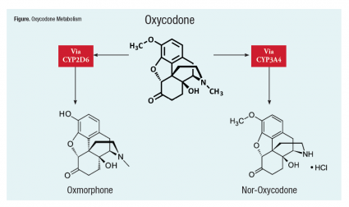
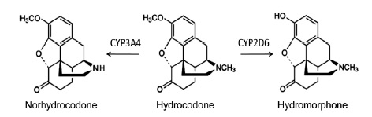
Oxycodone and Hydrocodone
Both have analgesic properties and are metabolized into more potent agents
  Metabolism via CYP 2D6 and CYP 3A4
Notes:
Commonly prescribed for acute pain
Hydromorphone is 100x more potent then hydrocodone
CYP 3A5 is principle enzyme that metabolizes oxycodone to nor-oxycodone, minor pathway is CYP 2D6

Slide 29
Impact of Genetic Polymorphisms
Hydrocodone
Oxycodone
Significant differences in hydrocodone metabolites with CYP 2D6 and 3A5 polymorphisms
  10-fold increase in hydromorphone in UMs
Very small study showing differences in analgesia with OPRM1 polymorphisms
Significant differences in oxycodone metabolites with CYP 2D6 and 3A5 polymorphisms
Conflicting evidence regarding effect OPRM1 polymorphisms have on oxycodone response
Notes:
Hydrocodone may not be a good alternative in 2D6 polymorphisms, but there is a significant lack of evidence
Oxycodone has intrinsic analgesic activity, it will difficult to not recommend against the use of oxycodone as empiric pain management, although CPIC recommends against its use in 2D6 UM or PMs

Slide 30
Morphine
Pharmacologically active opioid that undergoes phase II metabolism, which leads to elimination
  Metabolites can accumulate in renal failure
UGT1A1 (minor) and UGT2B7 (major) are the phase II enzymes
  Some conflicting data regarding polymorphisms in UGT2B7 and its affects on morphine levels
Notes:
No need to worry about polymorphisms in CYPs
Metabolites include m3g and m6g, the latter being pharmacologically active
Study by Holthe and colleagues showed morphine levels were comparable across groups with differing functioning on UGT function
Study by Darbari and colleagues showed that patients with lower functioning UGT 2B7 had less circulating M3G and M6G

Slide 31
Impact of Genetic Polymorphisms on Morphine Therapy
OPRM1 gene provides instructions for making the MORs
  Several studies demonstrate the presence of the G variant leads to reduced analgesic response
Gong XD, et al
  Study of 112 cancer patients
  Goal pain score of <4
  Significant difference in average morphine dose to achieve pain goal between OPRM1 groups
    AA: 72.464 mg, AG: 97.369 mg, and GG: 152.383 mg, p=0.005
Other studies have shown no significant difference in response
Notes:
AA homozygous normal
GG homozygous polymorphism
Other studies in the post-op population showed similar results

Slide 32
Other Opioids of Interest
Hydromorphone
Pharmacologically active
Phase II metabolism via UGT2B7
Fentanyl
Pharmacologically active
Phase I metabolism via CYP3A4
Methadone
Pharmacologically active
Complicated metabolism via multiple phase I enzymes
Lacks consistent data, OPRM1 likely most significant
More research needed due to complex metabolism
Lacks consistent data, OPRM1 likely most significant

Slide 33
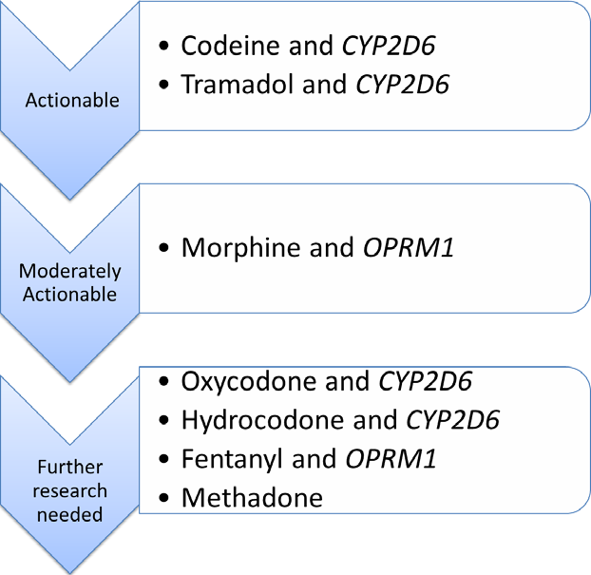

Slide 34
CPIC Recommendations

Slide 35
Which of the following opioids are contraindicated for use in pediatric patients <12 years old?
A. Oxycodone
B. Tramadol
C. Codeine
D. 2 of the above
E. All of the above

Slide 36
Which of the following opioids are contraindicated for use in pediatric patients <12 years old?
A. Oxycodone
B. Tramadol
C. Codeine
D. 2 of the above
E. All of the above

Slide 37

Putting it All Together!

Slide 38
Patient Case
Anita Paynepil is a 77 year-old female who presents to your primary care clinic with worsening low back pain that she rates as an 8/10
Past Medical History
  Degenerative lumbar disc disease (L2-L3)
    Has underwent two spinal fusions and an open discectomy
  Major depression
  Hypothyroidism
  Chronic pain
  CKD Stage III
Notes:
States pain at baseline is typically manageable at 3-4/10, but when she was out shoveling snow she noticed a “throbbing pain” in her lower back and now has become unbearable

Slide 39
Home Medications
Acetaminophen 650 mg 4x/day
Diclofenac sodium gel 1 application 4x/day to low back
Morphine 15 mg every 6 hours as needed
Gabapentin 300 mg daily
Venlafaxine ER 75 mg daily
  Recent dose reduction by psychiatrist
Levothyroxine 112 mcg daily
Women’s multivitamin
Notes:
Noted increased confusion and tachycardia on 150 mg/day

Slide 40
Patient Case Continued
Mrs. Paynepil states she has avoided opioids in the past due significant adverse effects
  Given tramadol for a previous injury, which led to severe drowsiness and confusion
  Her recently prescribed morphine dose has been ineffective
Patient’s daughter recommended she look into pharmacogenomics to help explain the patient’s medication intolerances
Mrs. Paynepil hands you her test results for your interpretation
Notes:
States she can’t make neither heads nor tails of the information

Slide 41
Which phenotype would you expect AP to express, based on the above information?
A. CYP 2D6 ultra-rapid metabolizer
B. CYP 2D6 poor metabolizer
C. CYP 2C9 poor metabolizer
D. CYP 2C9 ultra-rapid metabolizer
Notes:
2c9 phenytoin, warfarin, ARBs, multiple NSAIDs, sulfonylureas

Slide 42
Which phenotype would you expect AP to express, based on the above information?
A. CYP 2D6 ultra-rapid metabolizer
B. CYP 2D6 poor metabolizer
C. CYP 2C9 poor metabolizer
D. CYP 2C9 ultra-rapid metabolizer
Notes:
2c9 phenytoin, warfarin, ARBs, multiple NSAIDs, sulfonylureas
Venlafaxine is also activated to o-desmethylvenlafaxine, which is responsible for the primary effects. With more being activated, patient may experience more adverse effects, which is consistent with the patient’s story

Slide 43
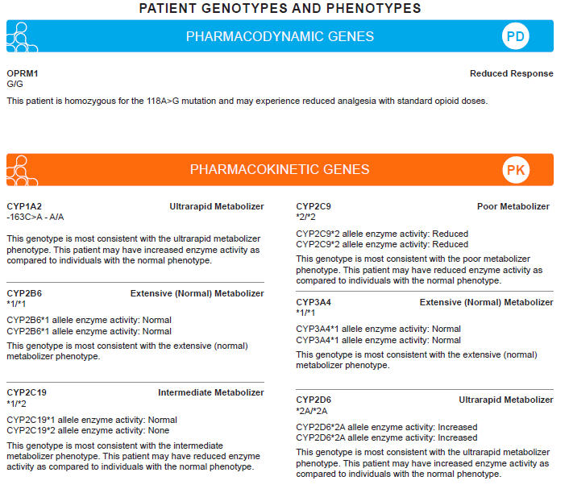
Notes:
Not very patient-friendly
Get all sorts of questions. Some questions I have had include “what do all the numbers and letters mean?” Will this tell me what medications won’t work for me? Does this explain why drug x caused this side effect? I’ve even had patients ask me things like, is it hard for you to find pants in stores? And Do you think my grandson will get as tall as you? Well your grandson is 6’2” and is 34 years old, I doubt it…

Slide 44
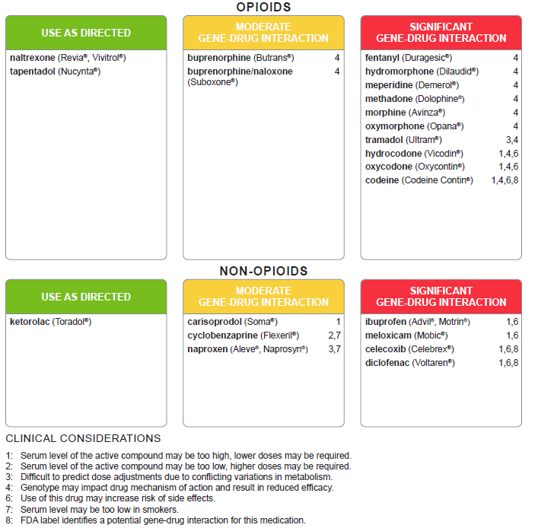

Slide 45
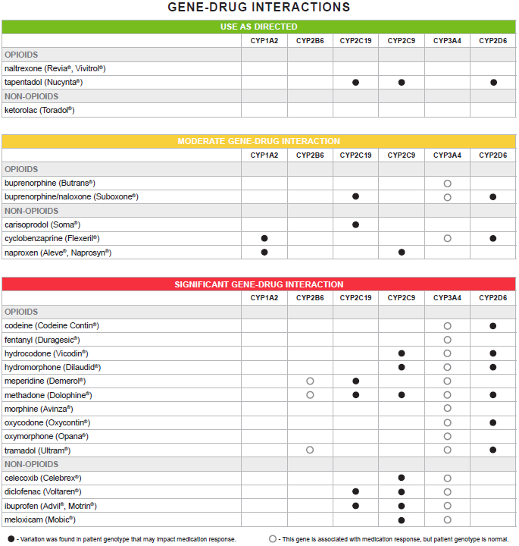

Slide 46
Which opioid regimen would be most appropriate for our patient?
A. Fentanyl transdermal patch 25 mcg/hr every 72 hours
B. Oxycodone 5-10 mg every 4-6 hours as needed
C. Hydromorphone 2 mg every 4 hours as needed
D. Tramadol 50 mg every 6 hours as needed
Notes:
Fentanyl for chronic pain: Patients who are considered opioid-tolerant are those who have been taking, for a week or longer, at least 60 mg of morphine daily, or at least 30 mg of oral oxycodone daily, or at least 8 mg of oral hydromorphone daily, or an equianalgesic dose of another opioid.

Slide 47
Which opioid regimen would be most appropriate for our patient?
A. Fentanyl transdermal patch 25 mcg/hr every 72 hours
B. Oxycodone 5-10 mg every 4-6 hours as needed
C. Hydromorphone 2 mg every 4 hours as needed
D. Tramadol 50 mg every 6 hours as needed

Slide 48
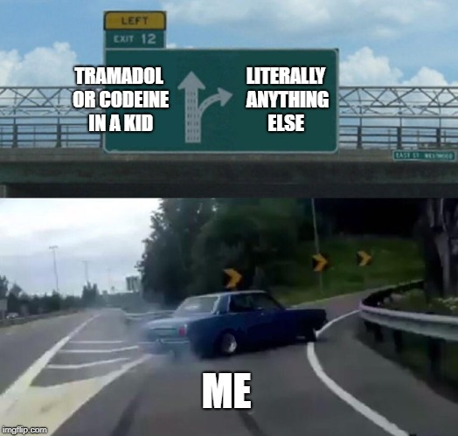
Conclusion
Opioids are metabolized via the liver and can be affected by polymorphisms in various liver enzymes
  Phase I enzymes
  Phase II enzymes
CPIC has only published one guideline in opioid pharmacogenomics
  More to come?
  Dutch guidelines
Further research needed to further identify role of OPRM1 and CYP2D6 polymorphisms on opioid response

Slide 49
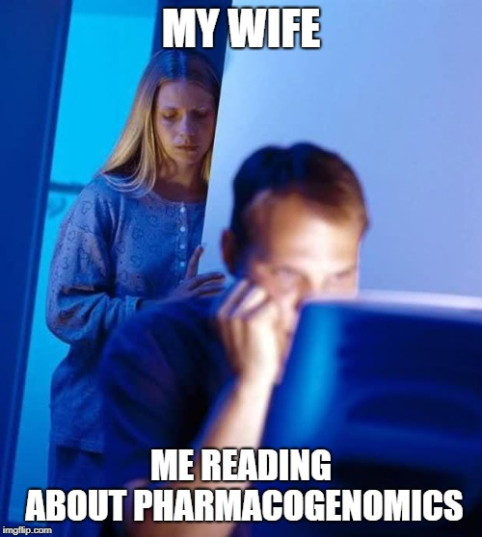
Questions?

