Slide 1
From barely surviving to thriving:
CNS role development in digital healthcare technology
Justin M. Smith, DNP, APRN, CNS
MN NACNS Fall 2022
October 07, 2022

Slide 2
Speaker disclosures:
NONE

Slide 3
Presentation outcomes
Learner will be able to describe at least one example of CNS practice in a digital product space
Learner will be able to articulate fundamentals of Agile project management as it relates to digital healthcare technology
Learner will be able to identify two to three productivity tools to support the CNS in moving from surviving to thriving

Slide 4
Frame of reference for your speaker:
Mayo Clinic Center for Digital Health
CNS Supporting the Care Anyplace portfolio of products
Care Anyplace products include:
Facilitated Self Care
Remote Patient Monitoring
Advanced Acute Care at Home
Anything stand out that feels strange?
PRODUCT
What is a digital healthcare product, and why does it matter?

Slide 5
How it works and why it matters
Example of facilitated self care solution
Mayo Clinic Care Plans (aka, Interactive Care Plans) deliver individualized education and health tracking tools to the Mayo Clinic app to build patient self-efficacy and enable early symptom and problem detection.

Slide 6
Features & functionality
Care Anyplace | Facilitated Self-Care
Mayo Clinic Care Plans integrate with the Mayo Clinic app.
Patients receive notifications on their mobile device to complete To Do tasks.
Questionnaires may include symptom check-ins, self-efficacy, and nicotine use.*
Education Library includes actionable guidance vetted by Mayo Clinic experts.*
Track My Health prompts patients to enter vital signs manually or via Bluetooth-connected device.*
*Varies by care plan.
Mayo Clinic Care Plans

Slide 7
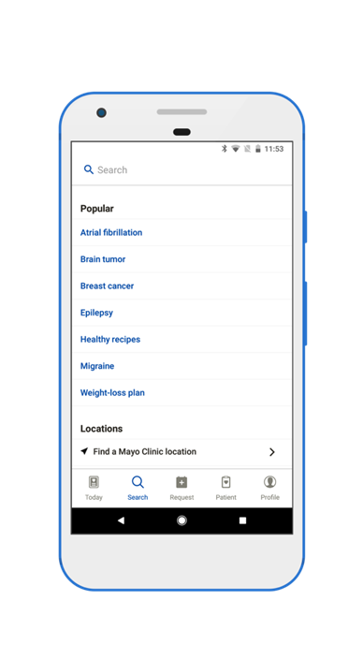
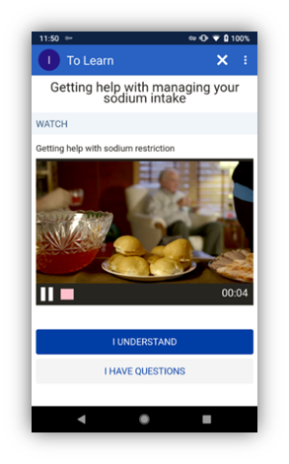
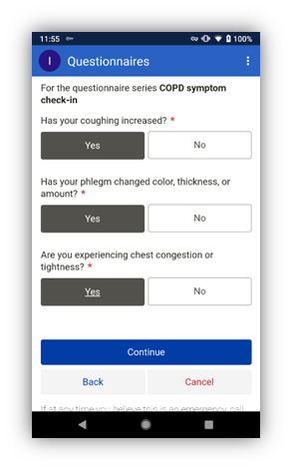
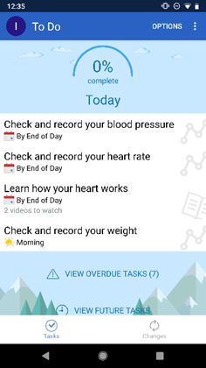
© 2022 Epic Systems Corporation. The Patient Online Services App is powered by MyChart® licensed from Epic Systems Corporation, © 1999 – 2022.

Slide 8
Agile ≠ Agile
Agile (adjective) able to move quickly and easily.
Agile (noun) a method of project management, used especially for software development, that is characterized by the division of tasks into short phases of work and frequent reassessment and adaptation of plans
Often paired with SCRUM, iteration plans and sprints, user stories, back log, and retrospective

Slide 9
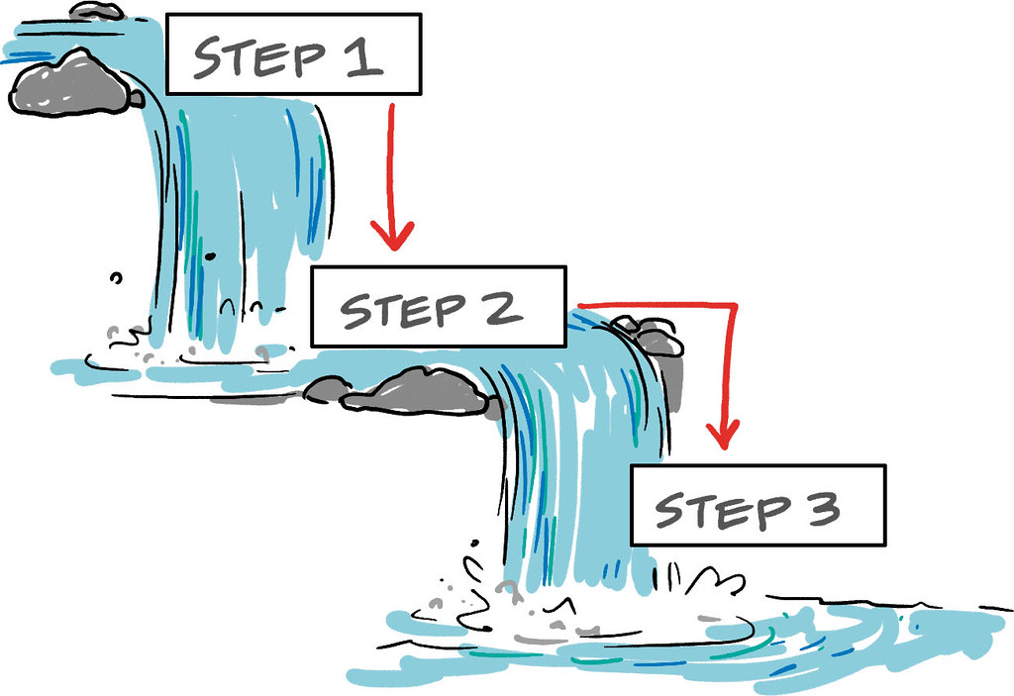
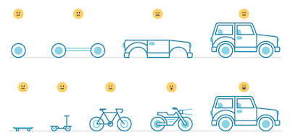
Waterfall vs. Agile
This Photo by Unknown Author is licensed under CC BY-SA
How does EBP fit
In Agile framework
This Photo by Unknown Author is licensed under CC BY

Slide 10
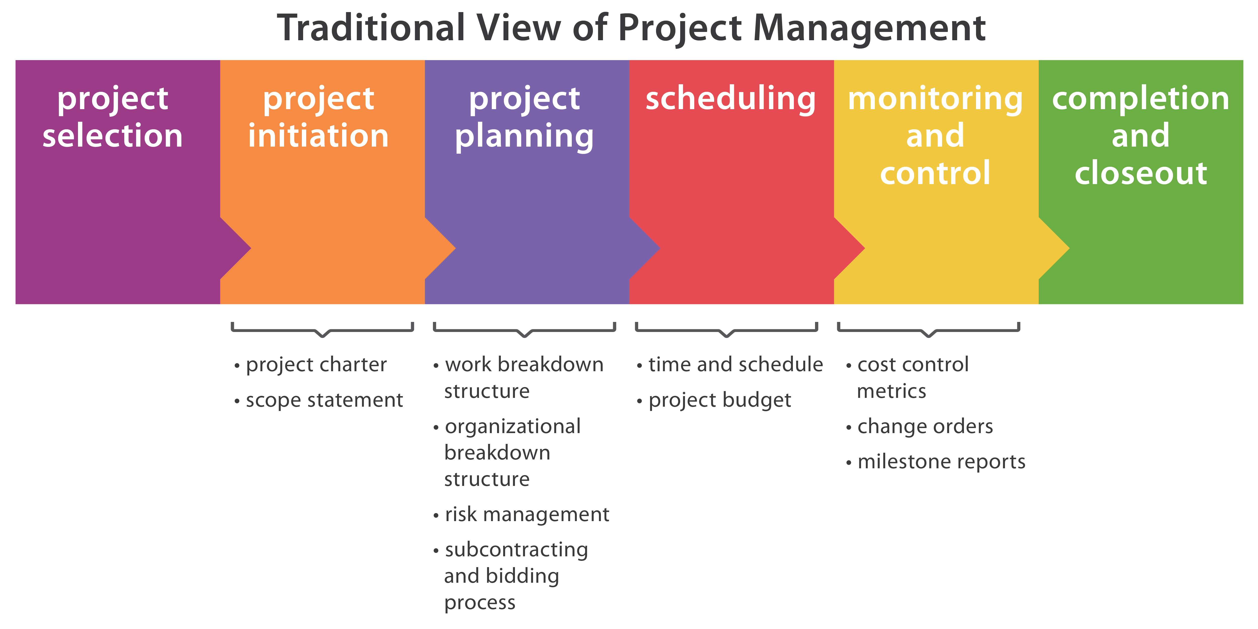
Product vs. Project
This Photo by Unknown Author is licensed under CC BY

Slide 11
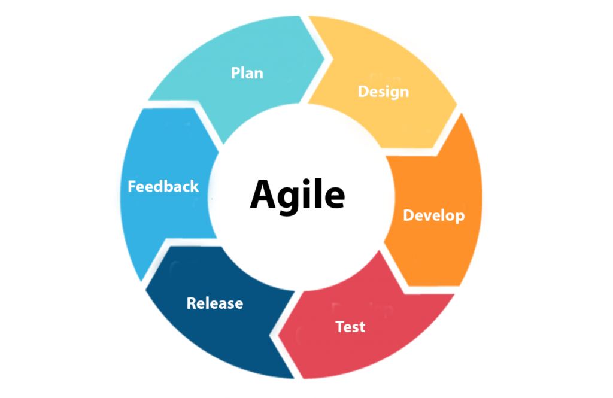
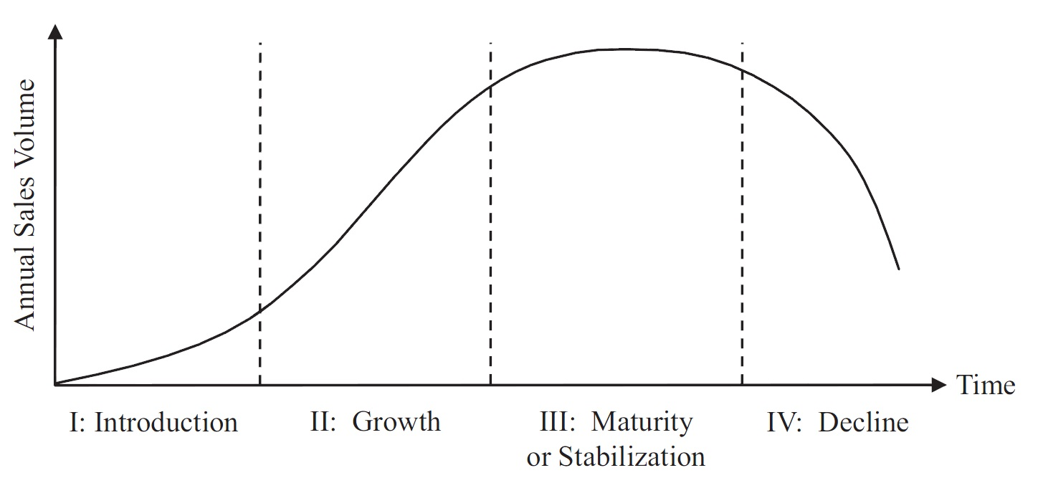
This Photo by Unknown Author is licensed under CC BY-NC-ND
This Photo by Unknown Author is licensed under CC BY

Slide 12
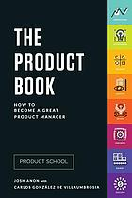
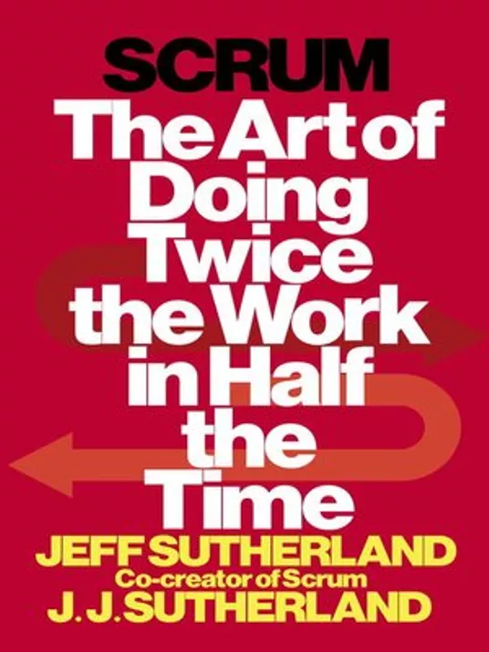
Tools for productivity
Up Skill
Take a course
Udemy, Coursera, etc.
Read a book
Push vs Pull
Subscribe to updates
Create mailbox rules to manage subscriptions
Integrate a digital to-do list into your processes
Anon, J., & Gonzalez de Villaumbrosia, C. (2017). The product book.
Sutherland J. & Sutherland J. J. (2014). Scrum : the art of doing twice the work in half the time (First). Crown Business

Slide 13
Thank you

